Slide 1
Making the machine work for you
Notes:
https://chatgpt.com/share/6723ad37-105c-800f-8aa6-f4e48fe4cd5f

Slide 2
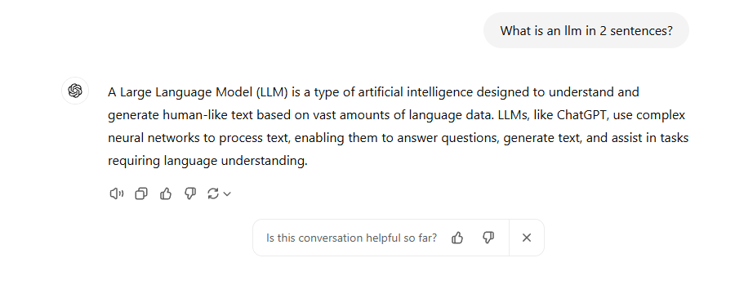
What is an LLM?

Slide 3
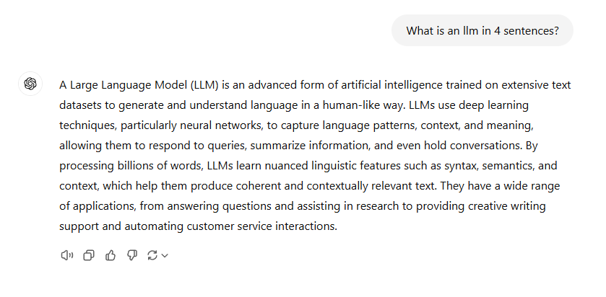
What is an LLM?

Slide 4
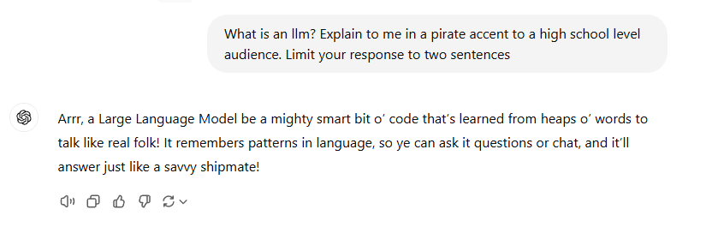
What is an LLM?

Slide 5
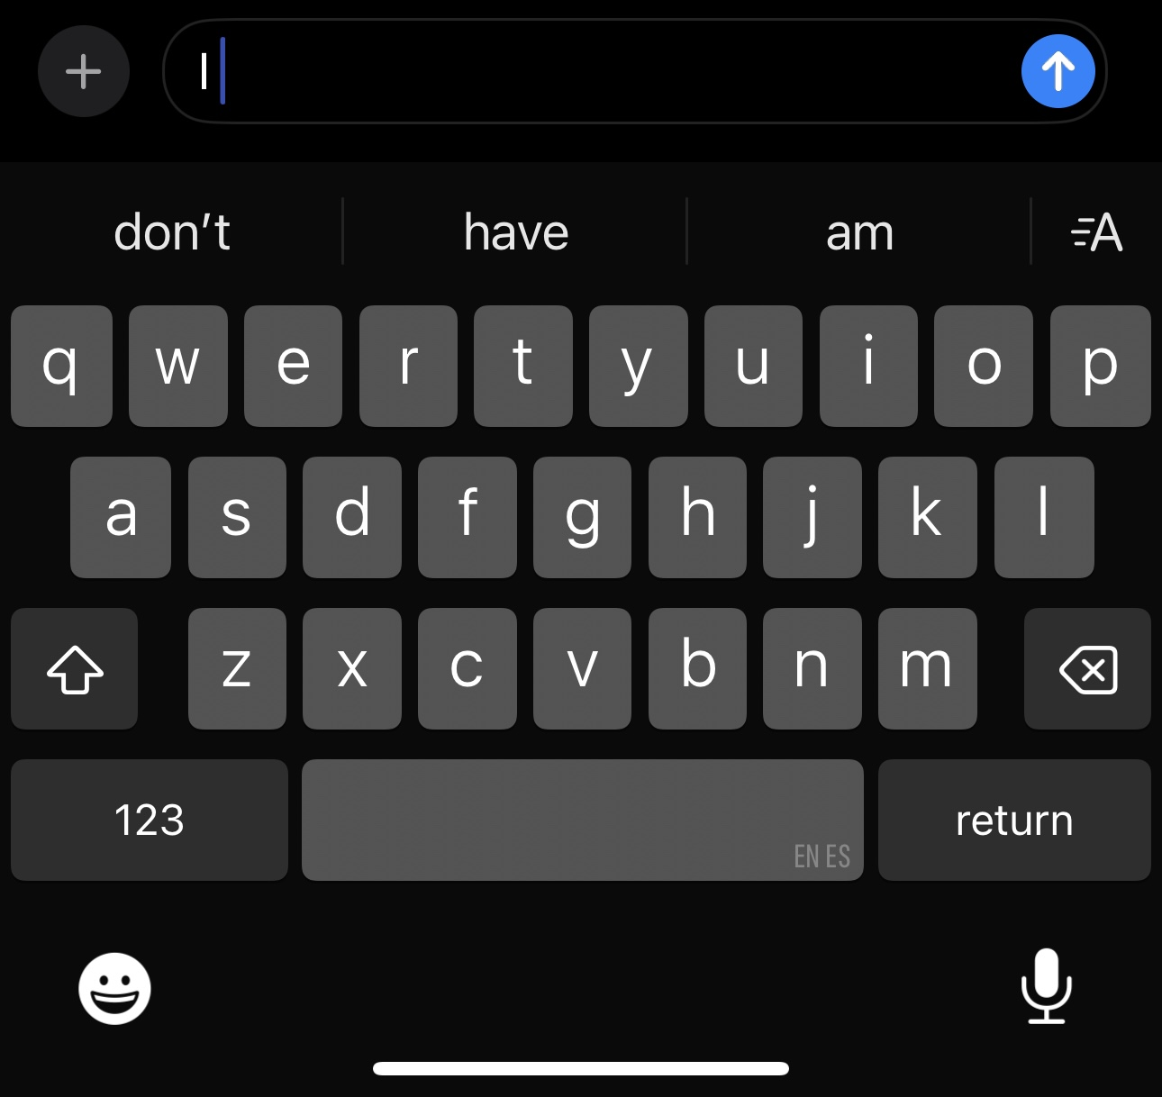
What is an LLM?
A pattern recognition generator trained on over 300 billion words for >$100,000,000
Can it “think”
No
Can it “read”
Mostly
Can it “code”
Most definitely
What’s the next word?
More or ____
Break a _____
I’m tired, I’m going to hit the _____
Stop beating around the ______
Barking up the wrong ______
I ______

Slide 6
What are its capabilities
What it can do
What it can’t
Regurgitate information it’s read
Sound eerily like a human
Explain complicated topics in new ways
Help with revising documents
Make great outlines for documents given a set of restrictions
Make largely functional code
Keep your sensitive information secure (in most cases)
Solve complex issues related to your research
Do your lit review (in most cases)
Debug code from your file with over 1000 lines
Process your powerpoint slides and generate high quality test questions

Slide 7
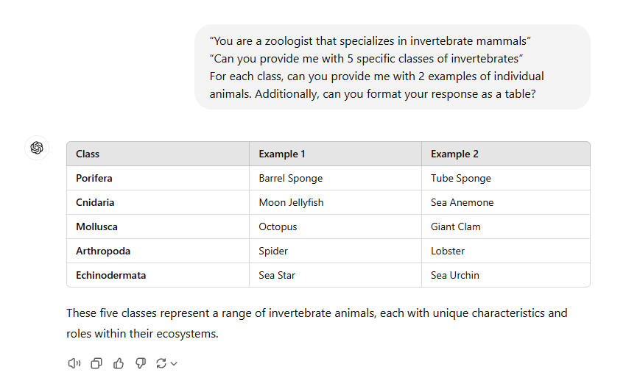
How do you “Engineer” prompts?
Start simple
Break questions into chunks
Be specific
Both about what you want the model to do and how you want it to look
If possible give an example
Three pronged attack
“You are a zoologist that specializes in invertebrate mammals”
“Can you provide me with 5 specific classes of invertebrates”
“For each class, can you provide me with 2 examples of individual animals. Additionally, can you format your response as a table?”

Slide 8
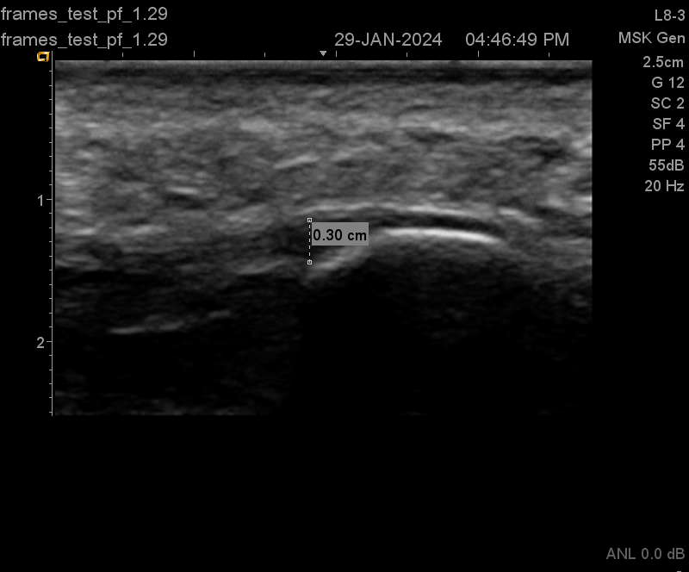
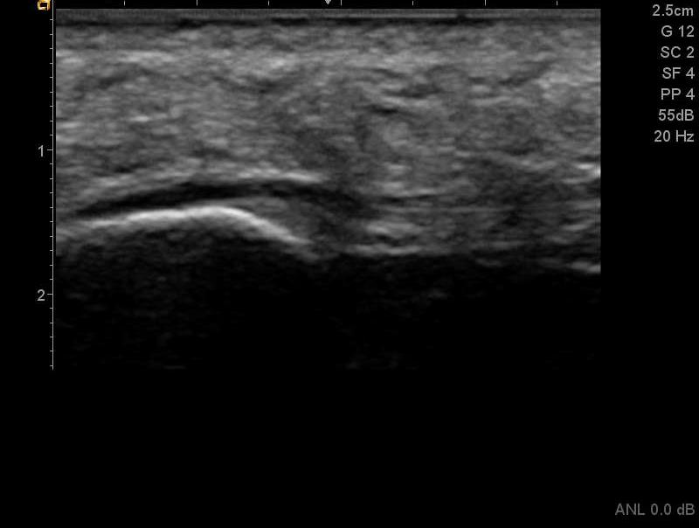
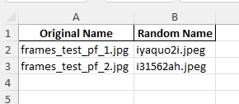
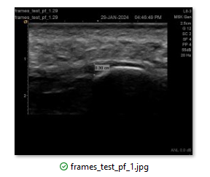
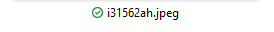
The problem
The solution
Notes:
https://chatgpt.com/share/6723ad37-105c-800f-8aa6-f4e48fe4cd5f

Slide 9
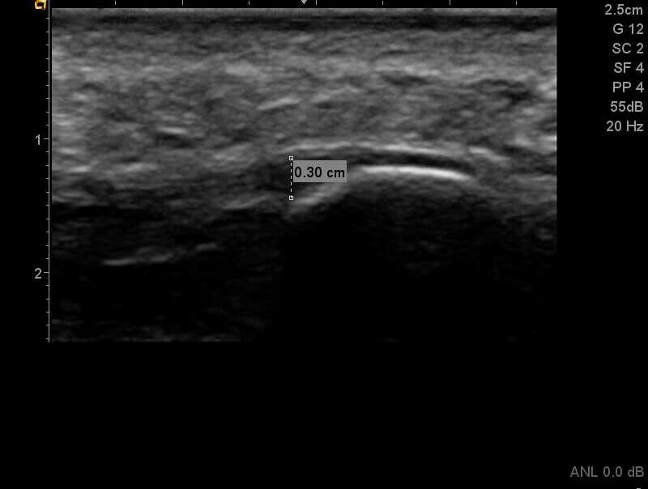
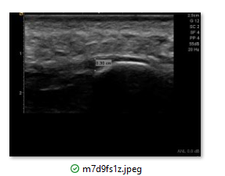
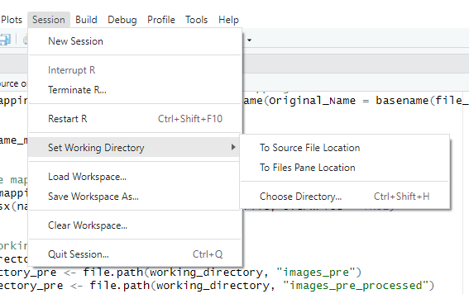
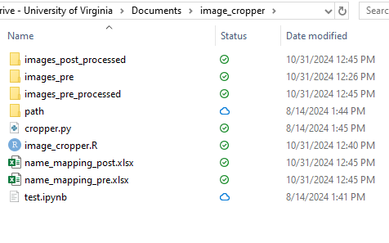
Now in R
What’s the difference in the code?

Slide 10
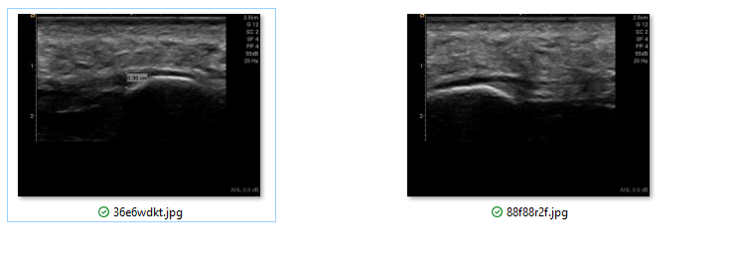
Now in matlab
Needed an extra step

Slide 11
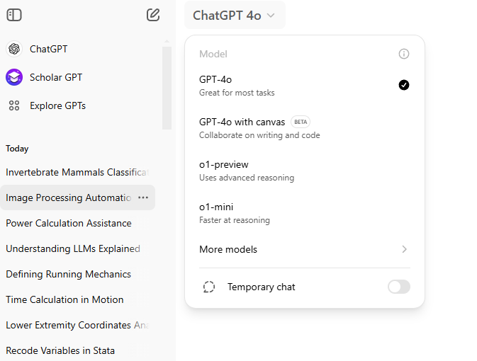
New features

